Slide 1

DEPARTMENT OF COMPUTER SCIENCE AND ENGINEERING
Title: A Generative AI and RAG-Based Intelligent System for Automated Smart Campus Problem Detection and Resolution
BATCH ID : 23MPCS-G6
S. No | Roll. No | Student Name
1 | 23881A05CB | B. SANDEEP
2 | 23881A05CD | B. NAGASRI
3 | 23881A05DX | P. ARAVEEN
Guide Details
Ganesh Deshmukh
Assistant Professor
Department of CSE

Slide 2
Mini Project Outlines
Introduction
Existing System Vs Proposed
Research Gaps
Problem Statement
Proposed Project Objectives
Proposed Project Outcomes
Software and Hardware Requirements
Architectural Diagram
Proposed Methods and Algorithms
Results
Research Paper (Submission Proofs)
Conclusion

Slide 3
Introduction
Overview: An AI-powered complaint management platform designed for educational institutions to automate and streamline issue resolution.
Core Technology: Leverages Natural Language Processing (NLP), Generative AI (Google Gemini), and Retrieval-Augmented Generation (RAG).
Key Functionality: Automatically classifies student complaints, predicts issue priority, and instantly generates step-by-step resolution pathways (SOPs) to assist administrators.
Keywords: Generative Artificial Intelligence, Retrieval-Augmented Generation, NLP, Smart Campus, Automated Complaint Management

Slide 4
Existing System Vs Proposed
Feature | Existing Manual System | Proposed AI System
Submission | Paper registers or generic web forms. | OTP-verified intelligent web portal with role-based access.
Categorization | Manual routing by administrative staff. | Auto-classification into specific campus domains using NLP.
Prioritization | Reactive; all issues treated sequentially. | AI Priority Engine instantly detects urgency (High/Medium/Low).
Resolution Strategy | Admins rely on memory or physical SOP manuals. | RAG Pipeline auto-generates step-by-step action plans using GenAI.
Notifications | Slow, manual communication. | Automated EmailJS alerts for high-priority complaints.

Slide 5
Research Gaps
Lack of Domain-Specific Context: Traditional helpdesk software lacks an understanding of campus-specific infrastructure and academic domains.
Hallucinations in Pure GenAI: Purely generative models can produce inaccurate responses; there is a need to ground AI outputs in actual institution documents.
Absence of Generative Intelligence: Current systems only log problems but do not offer admins immediate, actionable solutions or Standard Operating Procedures (SOPs).
Delayed Triage: Real-time, automated urgency detection is missing, causing critical campus issues (like electrical hazards) to sit in the same queue as minor requests.

Slide 6
Problem Statement
Educational campuses receive many student complaints in unstructured text form.
Complaints are processed manually, which takes more time.
Manual classification and prioritization often cause delays and errors.
This lack of intelligent automation and real-time urgency detection leads to delayed triage, where critical issues sit alongside minor requests, causing student dissatisfaction.
Core Problem: There is an urgent need for an AI-based system capable of automatically classifying, prioritizing, and suggesting real-time, policy-compliant resolution strategies for campus-related problems.

Slide 7
Proposed Project Objectives
To develop an accessible platform with strict student verification (Roll Number/ID format) for seamless reporting.
To automatically classify student complaints based on category and priority using NLP and Generative AI.
To implement a Retrieval-Augmented Generation (RAG) pipeline to retrieve relevant campus Standard Operating Procedures (SOPs) for each specific complaint.
To convert unstructured complaint text into structured, accurate, and policy-compliant administrative tickets and action plans.
To automate critical incident notifications via email for rapid administrative intervention.
DEPARTMENT OF CSE : MINI PROJECT

Slide 8
Proposed Project Outcomes
Reduced Response Time: Instant elimination of manual sorting and triaging via AI-driven classification.
Enhanced Administrative Efficiency: Admins receive ready-to-execute action plans rather than just raw complaint data.
Data-Driven Decisions: Identification of frequently recurring campus issues through interactive Chart.js analytics.
Improved Reliability: Significant reduction in AI hallucinations by grounding responses strictly in retrieved campus SOPs.
Scalable Architecture: A fully operational framework running on Serverless Python & React, capable of institution-wide deployment.
DEPARTMENT OF CSE : MINI PROJECT

Slide 9
Software and Hardware Requirements
Software Requirements:
Frontend: React 18, React Router, Chart.js, Framer Motion, standard CSS.
Backend / AI Engine: Python 3.9+, standard built-in libraries (json, re, urllib), Google Gemini AI API.
Deployment & Services: Vercel Serverless Functions, EmailJS (for OTP and alerts), Node Package Manager (npm).
Hardware Requirements:
For Development/Admin: Any modern PC/Laptop (Minimum 4GB RAM, Dual-core CPU).
For End Users: Standard Web Browser on Mobile/Desktop with an active Internet connection.
DEPARTMENT OF CSE : MINI PROJECT

Slide 10
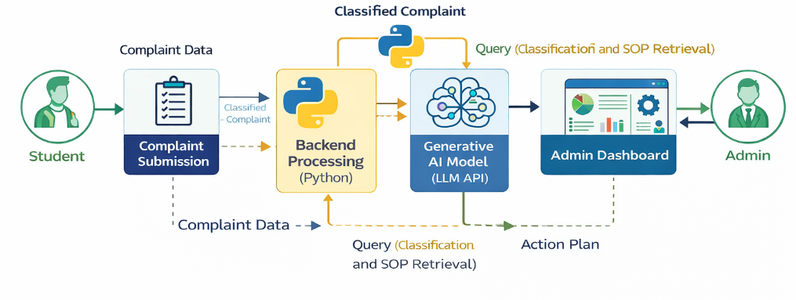
Architectural Diagram
DEPARTMENT OF CSE : MINI PROJECT

Slide 11
PROPOSED METHOD AND ALGORITHMS
Natural Language Processing (NLP): Utilized for text tokenization, keyword extraction, and pattern matching to compute confidence scores for strict categorical grouping of unstructured complaints.
Priority Prediction Algorithm: A hybrid rule-based system that analyzes sentence severity, urgent keywords (e.g., "broken," "hazard"), and domain weightings to map the complaint to Low, Medium, or High priority thresholds.
Retrieval-Augmented Generation (RAG):
Retrieval: Maps the classified complaint to internally predefined college SOPs.
Generation: Augments the Gemini LLM prompt with the retrieved SOP context to generate precise, real-world action plans instead of generic AI hallucinations.
DEPARTMENT OF CSE : MINI PROJECT

Slide 12
Results
High Accuracy Triage: Computes categorization with distinct confidence percentages (e.g., identifying a broken fan correctly with 95% confidence).
Immediate Alerting: Proven capability to trap high-priority flags during the Python self-test and instantly route alerts to administrators.
Actionable Intelligence: Successfully transforms ambiguous student complaints into structured, readable tasks via the RAG pipeline.
Seamless UI/UX: Fast, interactive dashboard renders complex complaint data into visually intuitive charts for administration.
DEPARTMENT OF CSE : MINI PROJECT

Slide 13
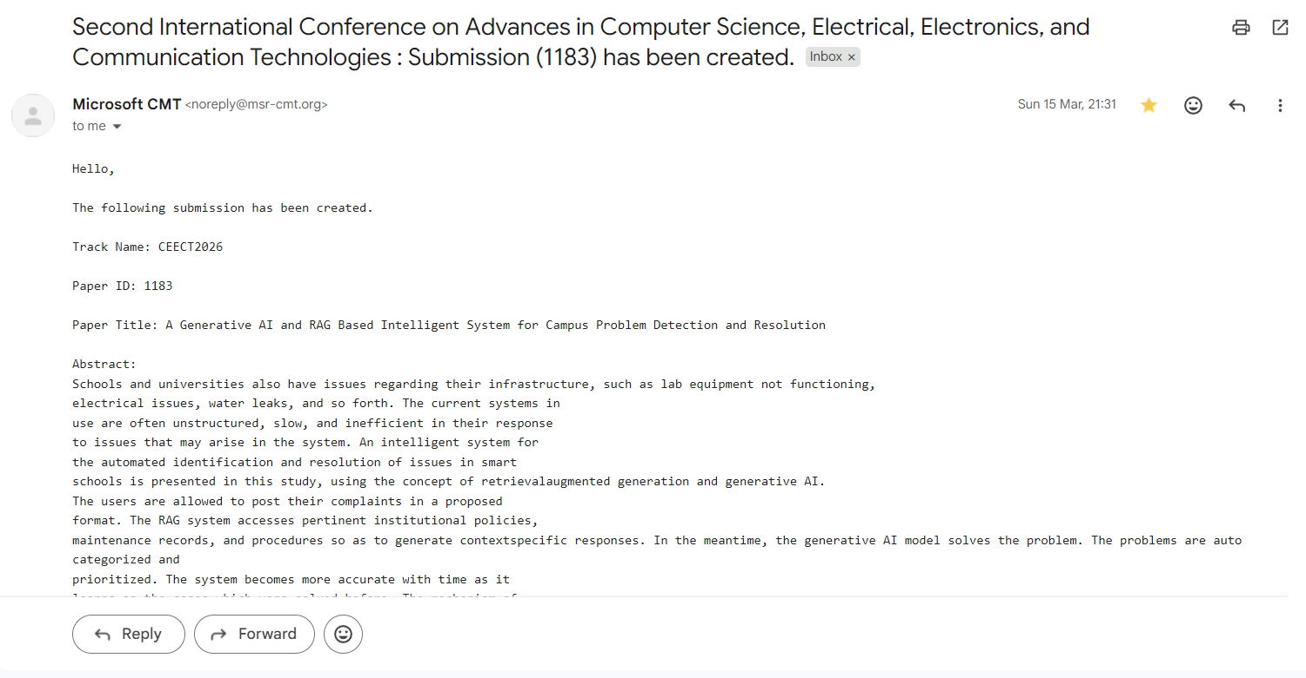
Research Paper (Submission Proof)
DEPARTMENT OF CSE : MINI PROJECT

Slide 14
Conclusion
The Smart Campus Problem Detection System successfully bridges the communication and operational gap between students and institution administration.
By replacing slow, manual workflows with an automated, NLP, and RAG-driven pipeline, the system not only logs complaints but intelligently drives their resolution.
It stands as a highly efficient, scalable, and modern application of Generative AI extending into everyday campus ecosystem management, ultimately enhancing student satisfaction and administrative productivity.
DEPARTMENT OF CSE : MINI PROJECT

Slide 15
Thank You
DEPARTMENT OF CSE : MINI PROJECT

